Slide 1
Theory of Automata (CSC- 402) Semester : Spring 2026 Credit Hours: 3

Slide 2
Theory of Automata Course
Lecture 4

Slide 3
CHAPTER 3 - Recursive Definations

Slide 4
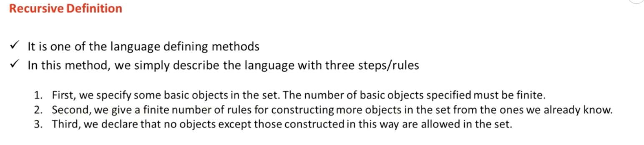
Recursive Defination in Automata

Slide 5
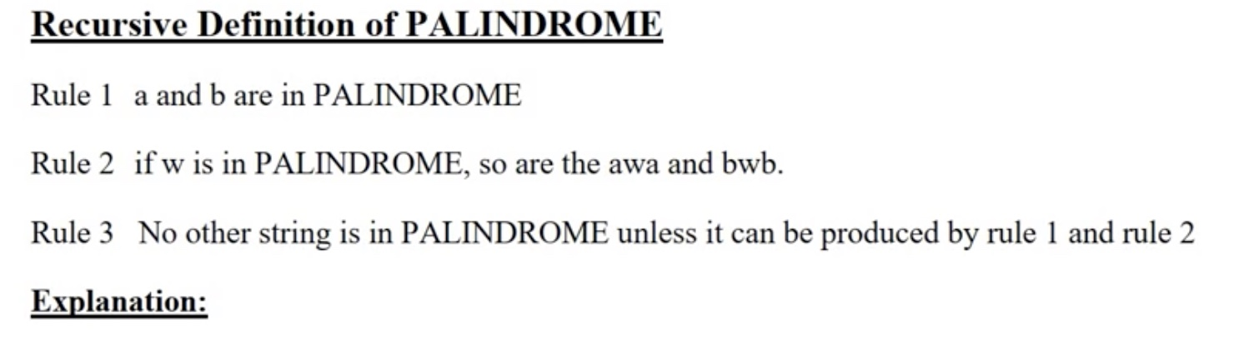
PALINDROME

Slide 6
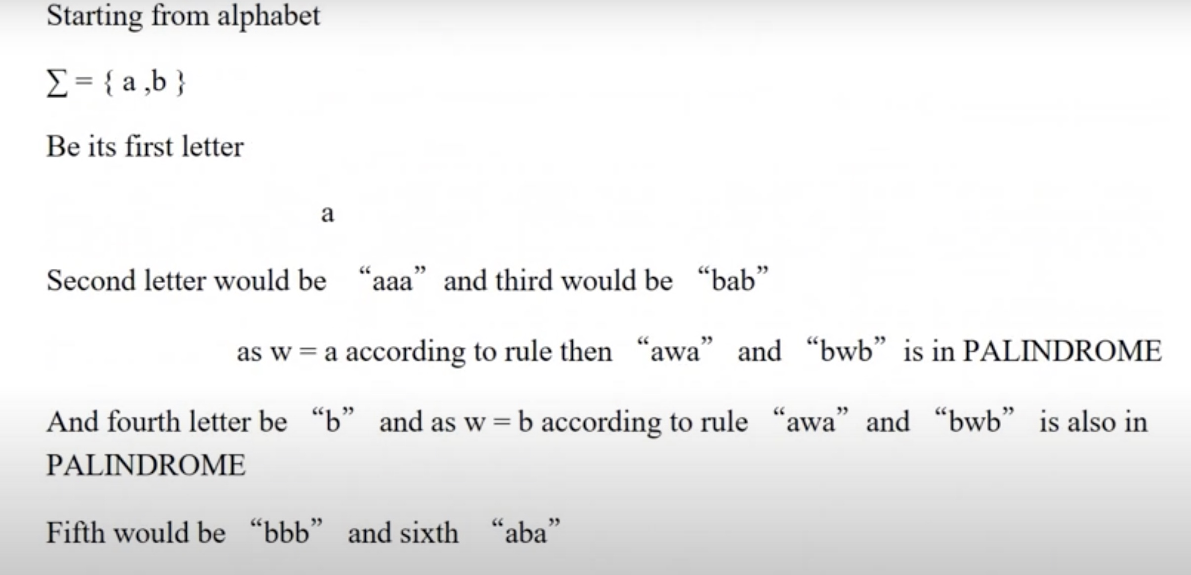
Explaination

Slide 7
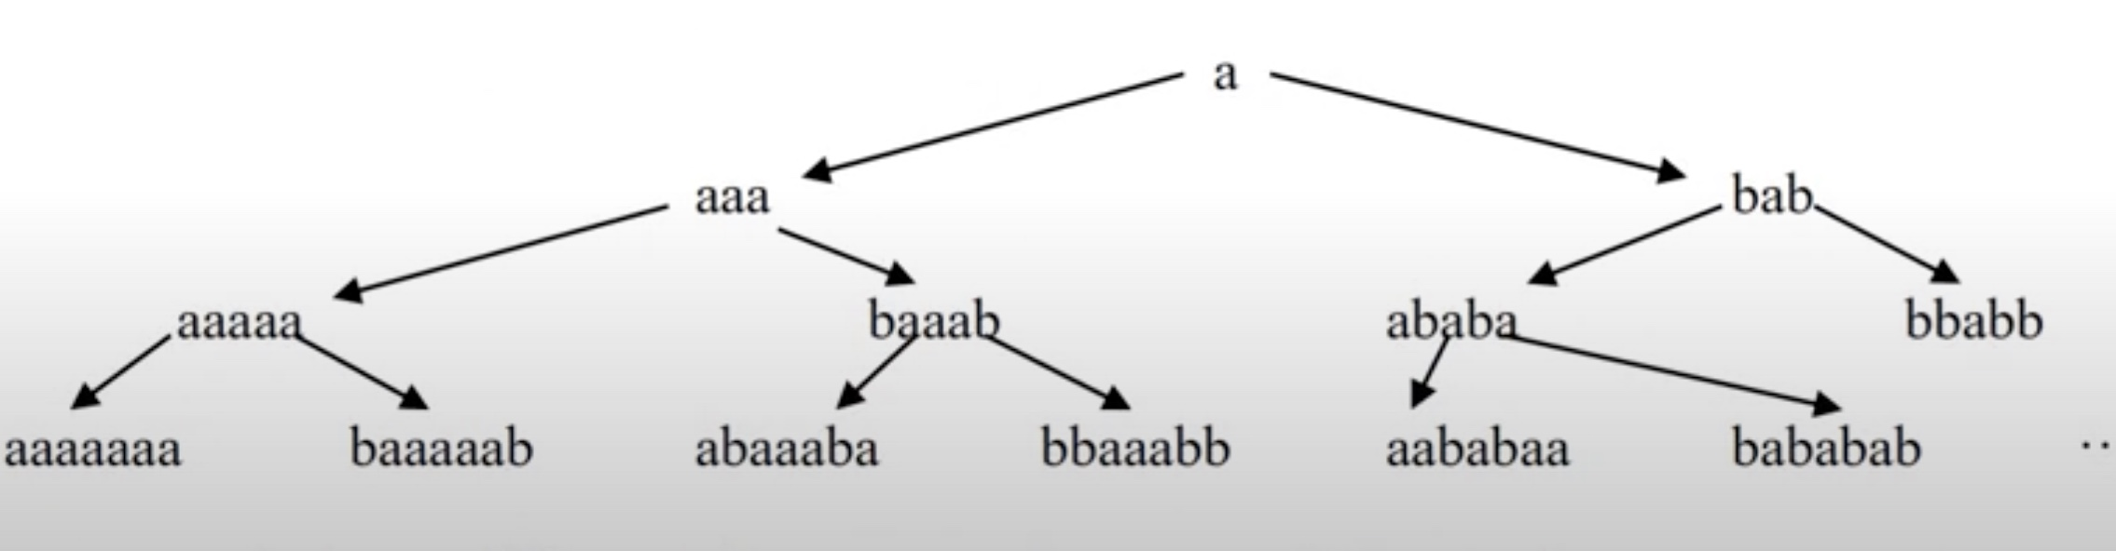
Explaination

Slide 8
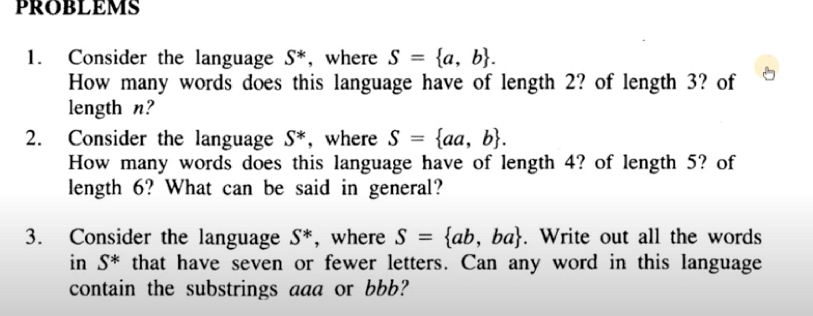
Some practise Problems

Slide 9
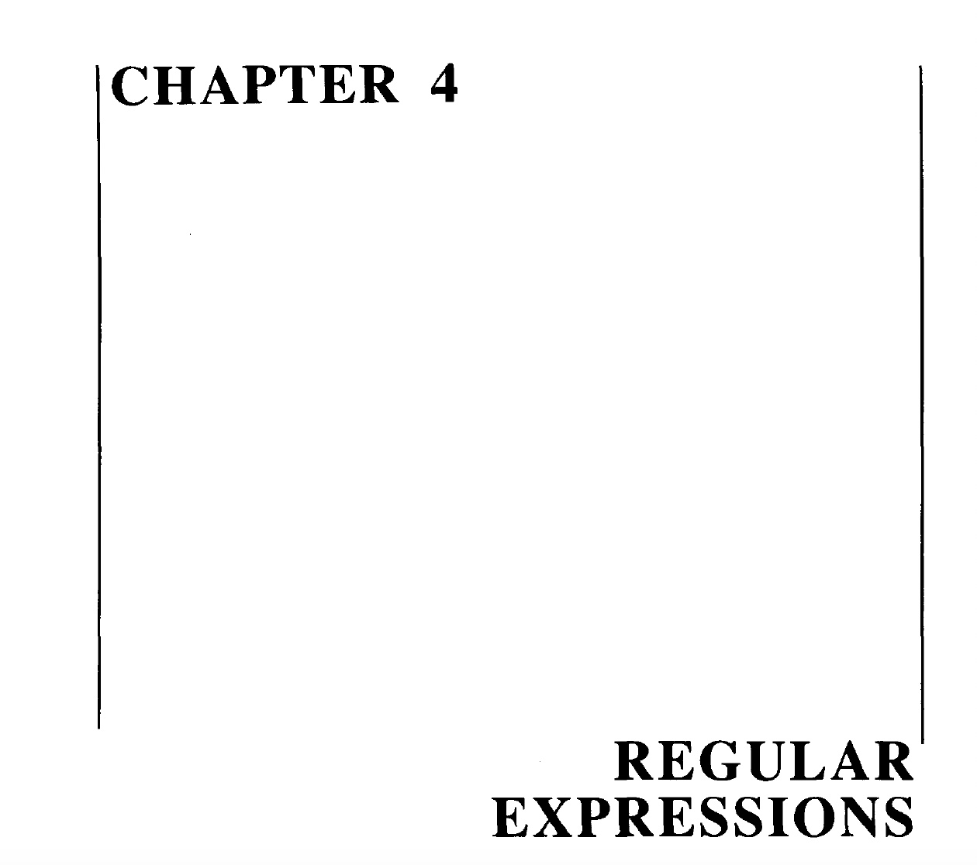

Slide 10
Recursive definition of Regular Expression(RE)
Step 1: Every letter of Σ including Λ is a regular expression.
Step 2: If r₁ and r2 are regular expressions then
(r₁)
r₁ r₂
r₁ + r₂ and
r₁*
are also regular expressions.
Step 3: Nothing else is a regular expression.

Slide 11
Defining Languages (continued)…
Method 3 (Regular Expressions)
Consider the language L={Λ, x, xx, xxx,…} of strings, defined over Σ = {x}.
We can write this language as the Kleene star closure of alphabet Σ or L=Σ*={x}*
this language can also be expressed by the regular expression x*.
Similarly the language L={x, xx, xxx,…}, defined over Σ = {x}, can be expressed by the regular expression x⁺.

Slide 12
Cont.
Now consider another language L, consisting of all possible strings, defined over Σ = {a, b}. This language can also be expressed by the regular expression
(a + b)*.
Now consider another language L, of strings having exactly double a, defined over Σ = {a, b}, then it’s regular expression may be
b*aab*

Slide 13
Cont.
Now consider another language L, of even length, defined over Σ = {a, b}, then it’s regular expression may be
((a+b)(a+b))*
Now consider another language L, of odd length, defined over Σ = {a, b}, then it’s regular expression may be
(a+b)((a+b)(a+b))* or
((a+b)(a+b))*(a+b)

Slide 14
Remark
It may be noted that a language may be expressed by more than one regular expressions, while given a regular expression there exist a unique language generated by that regular expression.

Slide 15
Cont.
Example:
Consider the language, defined over Σ={a , b} of words having at least one a, may be expressed by a regular expression
(a+b)*a(a+b)*.
Consider the language, defined over Σ = {a, b} of words having at least one a and one b, may be expressed by a regular expression
(a+b)*a(a+b)*b(a+b)*+ (a+b)*b(a+b)*a(a+b)*.

Slide 16
Cont.
Consider the language, defined over
Σ={a, b}, of words starting with double a and ending in double b then its regular expression may be aa(a+b)*bb
Consider the language, defined over
Σ={a, b} of words starting with a and ending in b OR starting with b and ending in a, then its regular expression may be a(a+b)*b+b(a+b)*a

Slide 17
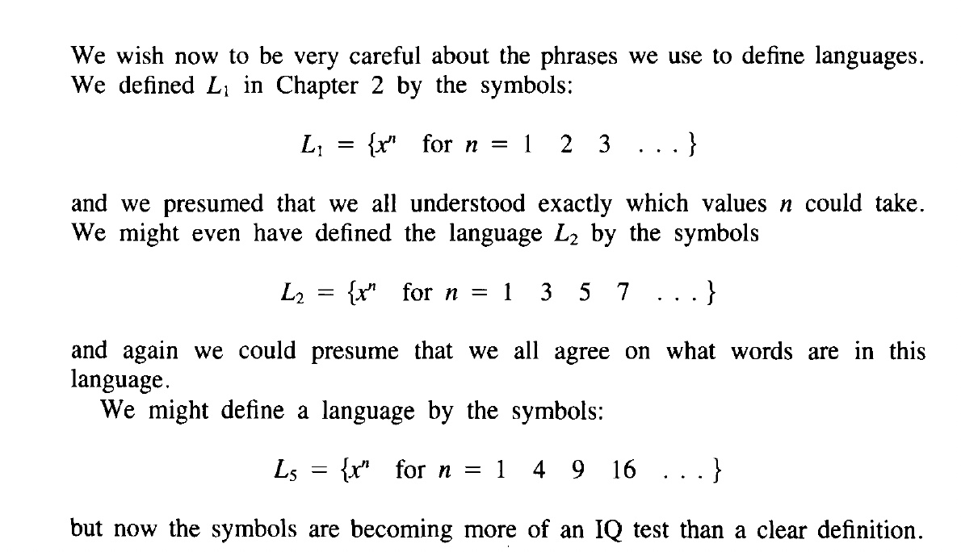
Regular Expressions

Slide 18
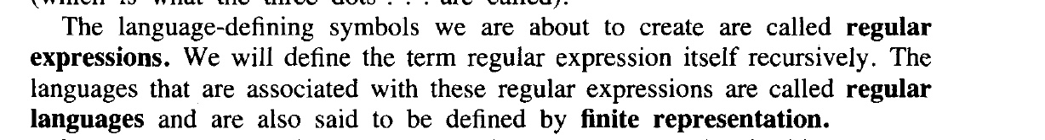
Regular Expression

Slide 19
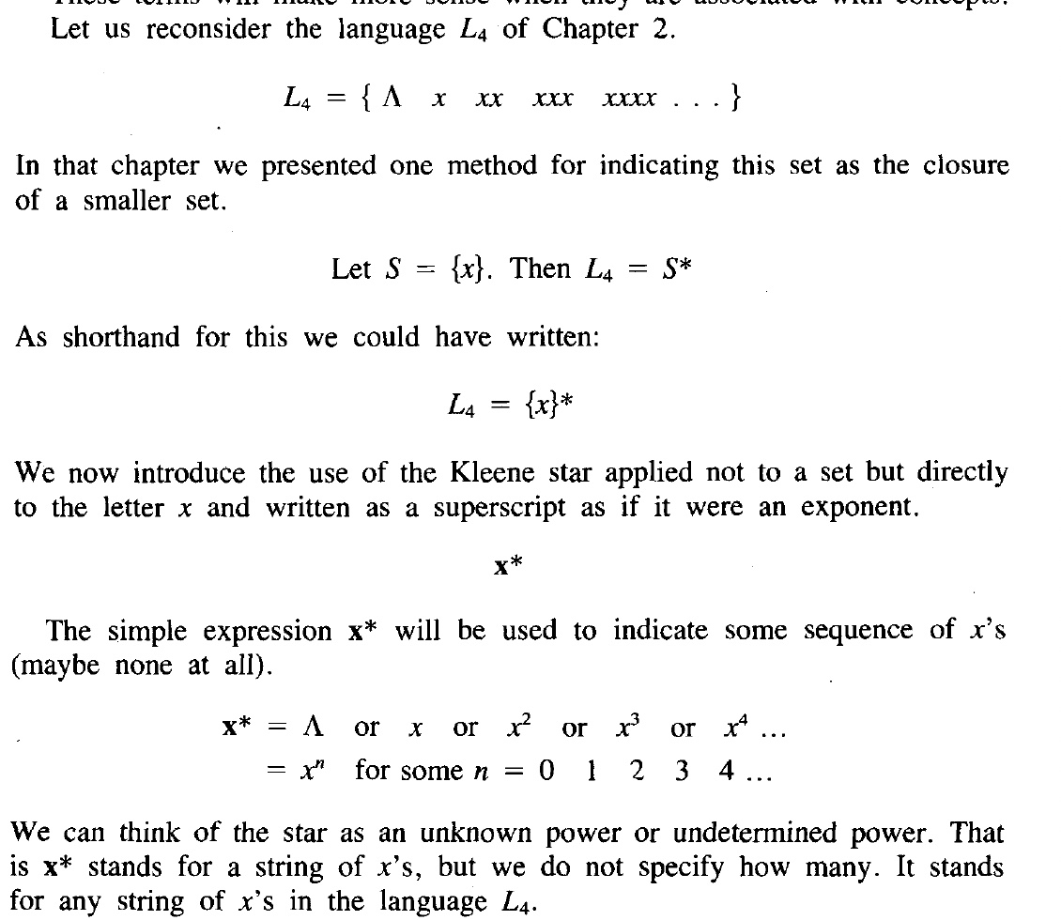
Regular Expression

Slide 20
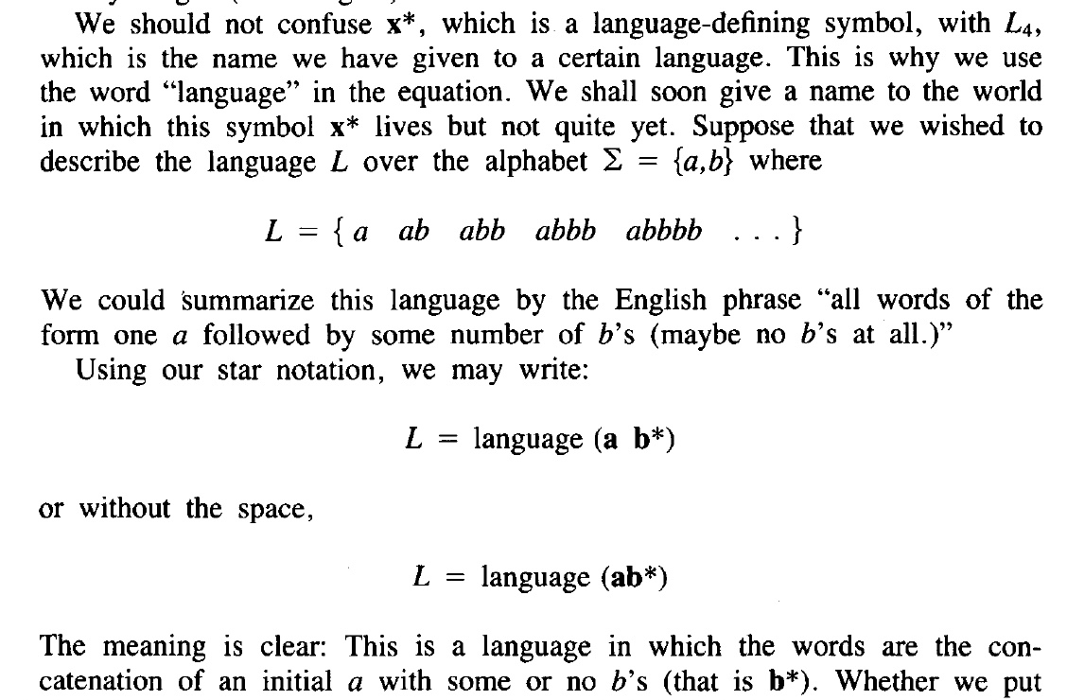

Slide 21
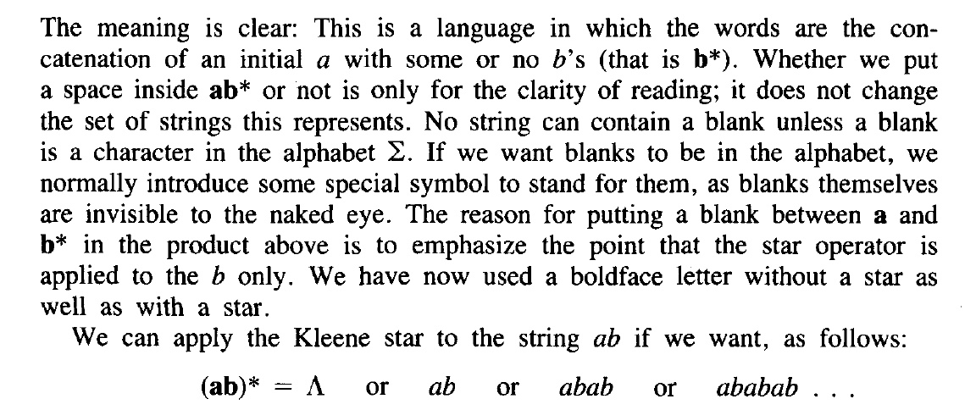

Slide 22
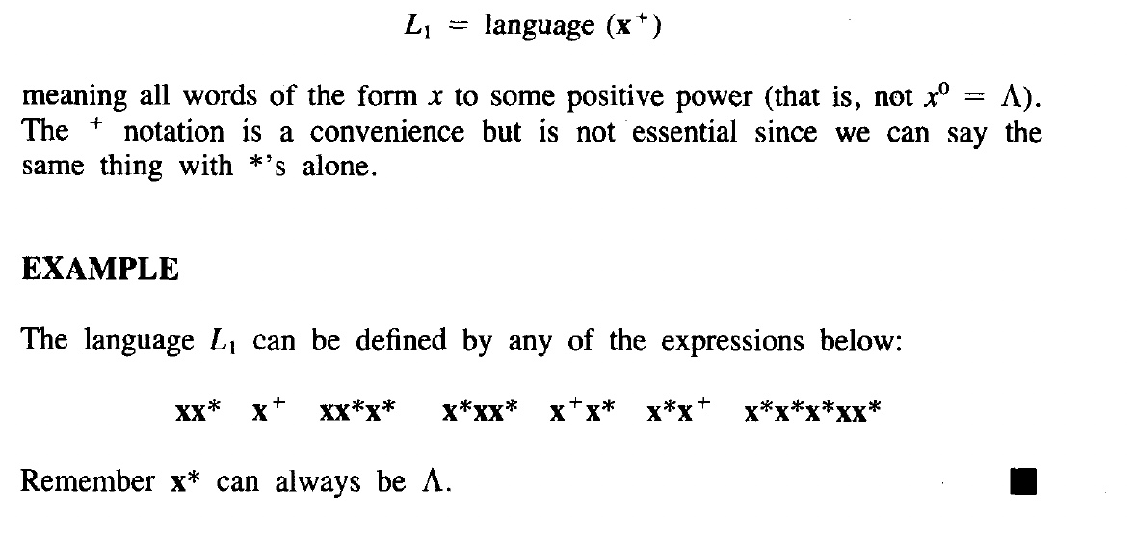
More examples

Slide 23
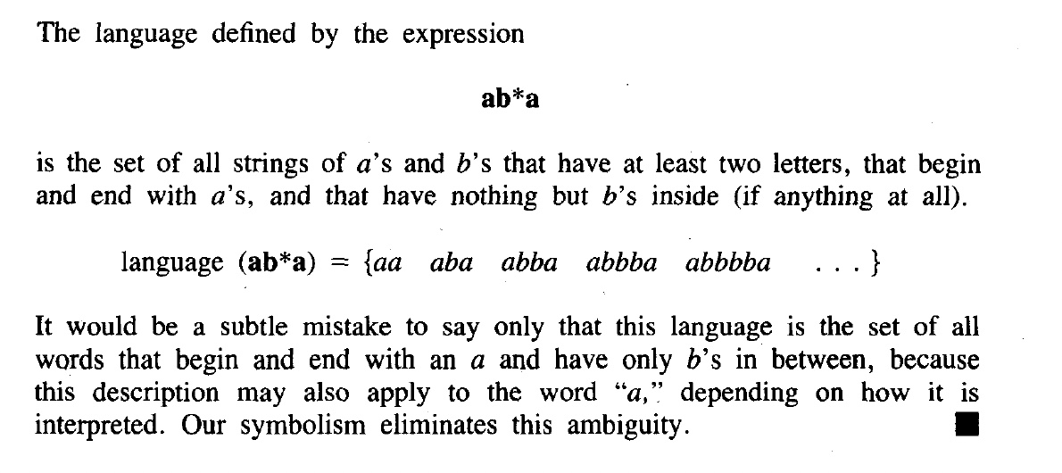
More examples

Slide 24
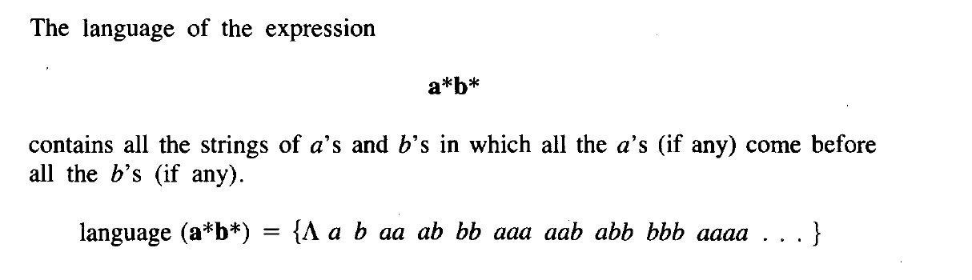
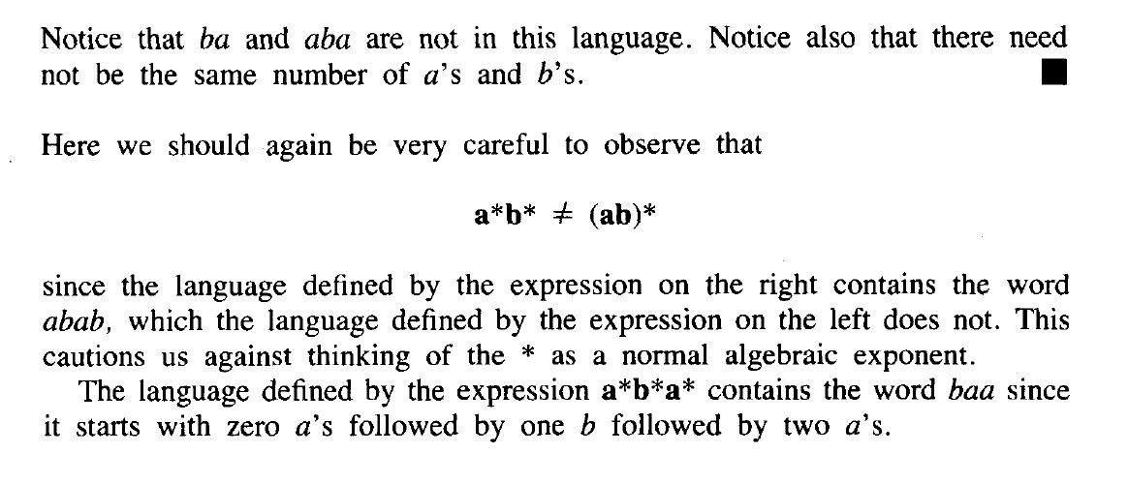
More examples

Slide 25
TASK
Consider the language, defined over
Σ={a, b} of words beginning with a, then its regular expression?
Consider the language, defined over
Σ={a, b} of words beginning and ending in same letter, then its regular expression

Slide 26
TASK
Consider the language, defined over
Σ={a, b} of words ending in b, then its regular expression Consider the language, defined over
Σ={a, b} of words not ending in a, then its regular expression

Slide 27
TASK
Consider the language, defined over
Σ={a, b} of words beginning with a, then its regular expression may be a(a+b)*
Consider the language, defined over
Σ={a, b} of words beginning and ending in same letter, then its regular expression may be (a+b)+a(a+b)*a+b(a+b)*b

Slide 28
TASK
Consider the language, defined over
Σ={a, b} of words ending in b, then its regular expression may be (a+b)*b.
Consider the language, defined over
Σ={a, b} of words not ending in a, then its regular expression may be (a+b)*b + Λ. It is to be noted that this language may also be expressed by ((a+b)*b)*.

Slide 29
End of Lecture

